Slide 1
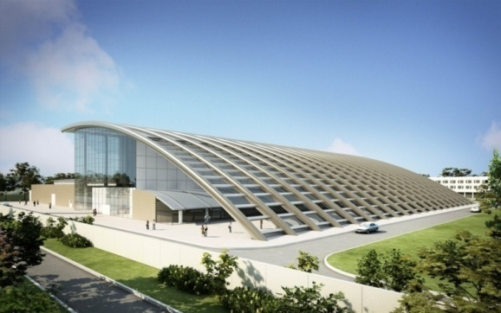
Vacuum System for Beam Transport
Catalin M. Ticos
National Institute for Lasers, Plasma and Radiation Physics (INFLPR),
077125 Bucharest, Romania

Slide 2
Engineering issues related to beam delivery to target
Motivation:
Identify engineering issues related to beam propagation in vacuum
Steps:
1. generation of PW laser beam (in compressor)
2. transport of PW laser beam to target
Peculiarities:
Max beam diam. 90 cm, large and heavy optics/vacuum compatible
Transport over large distances (~30m) with little distortions!

Slide 3
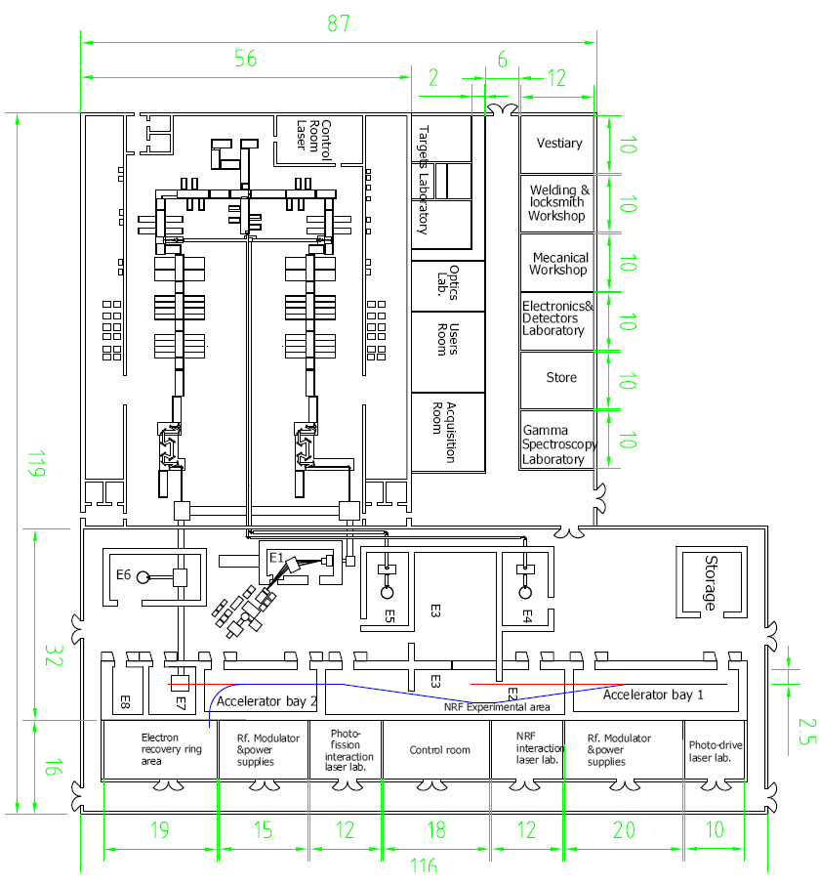
Large beams are in vacuum
Challenge:
Lasers and target areas on 2 different
concrete floors.
Both floors are supported by a
number of springs
μm to mm displacement within beam line
→mechanical stress
→ optical misalignment

Slide 4
Main issues
Required:
10⁻⁵ - 10⁻⁶ torr vacuum in beam pipes/compressors/chambers
Low (or no) vibrations along the beam line and at target chambers
Cooling of pumps (pipes /target chamber as well?)
Needed:
Proper vacuum system with integrated remote controls
(pumps, gauges, valves, gas containers, filters, exhausts, etc)
Reduce vibrations from mechanical/turbo pumps to pipes/compressor/ chamber
Water/air cooling system for pumps

Slide 5
Vibration/stability issues (2)
Large weight on floor can cause tilting
To estimate mass we need to identify thickness and type of material for compressor/target chamber/piping
e.g. Al large target chamber 3 t
Same SS target chamber can have 9 t (ρ_{SS}/ρ_{Al} =8/2.7)

Slide 6
Vacuum solutions
For Ø90 cm pipe → every 2 to 5m a turbo+roughing system
Roughing (mechanical): atm. to 10⁻² torr; turbo: 10⁻² to 10⁻⁶ torr
Vacuum line segmented with pneumatically operated gate valves
Cryogenic pumps on compressor and target chambers (~10⁴ l/s)
Backup system on compressor/target chambers based on turbopumps (repair or regeneration of cryopumps)

Slide 7
Vibrations solutions
Laser interferometer for measuring the micro-motion between the 2 floors (laser and experimental areas) & for alignment of large optics
Large bellows in the beam line
Special stands for roughing pumps (w. damping springs)
Special supports for target chambers (based on polymer layers)
Cryopumps instead of turbo pumps

Slide 8
Other issues
Large flanges with windows, also large viewing windows on compressor/target chamber
Filters on exhausts for containing nuclear debris
Separate vacuum pumps for Target Positioner System, or instrument manipulator (eg. TIM at LANL)etc

Slide 9
Conclusions
Prerequisite for a good design is to identify and set the system parameters
Tight collaboration with laser and civil engineering groups
Learn from the experience of other facilities worldwide
Work closely with companies to deliver the right solution
Thank you!

